Slide 1
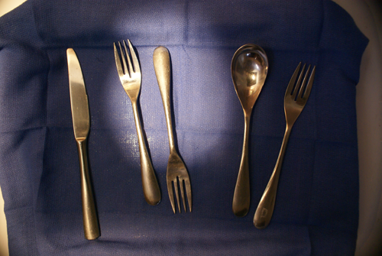
Use Imaging to Detect and Count Stainless Steel Flatware in a Tray
Project for CS 585
Imaging and Video Computing
Don Johnson

Slide 2
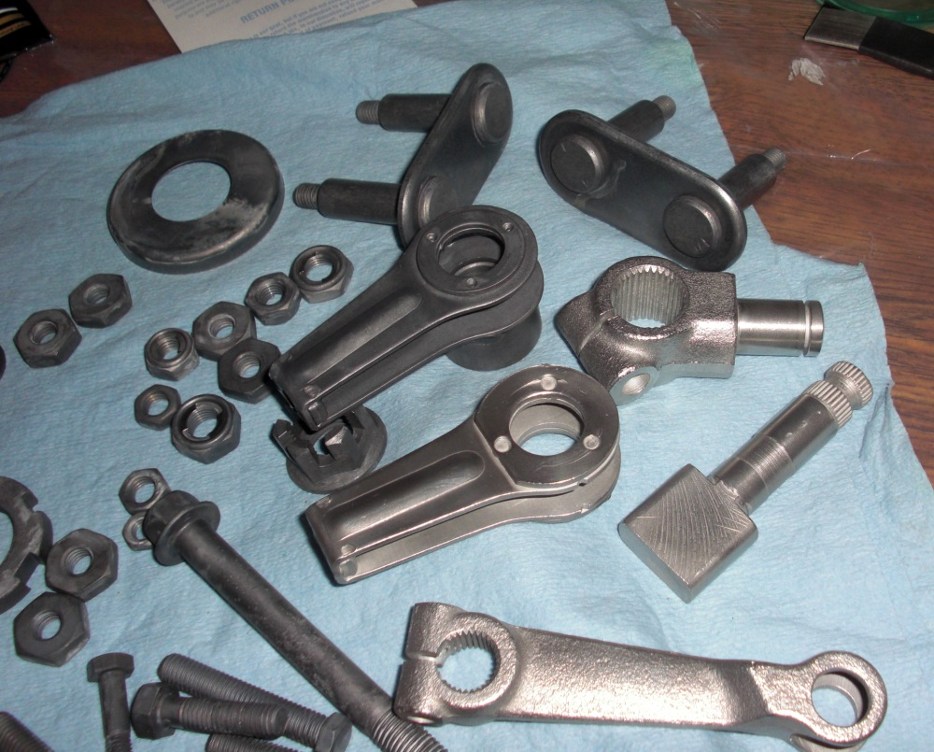
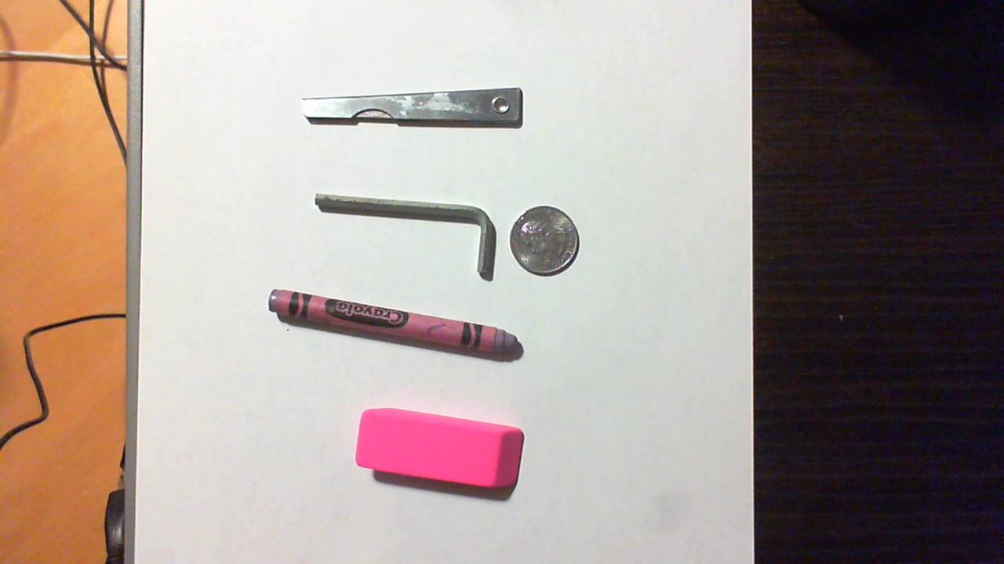
Motivation and Definition of Success
Potential industrial applications
Used a modified version of Zdenek Kalal’s OpenTLD system, which failed to count simple items
Would like to create a system that counts metallic items sitting in a tray with the same accuracy that could be achieved by a human
The process of counting the metallic objects should involve minimal human intervention

Slide 3
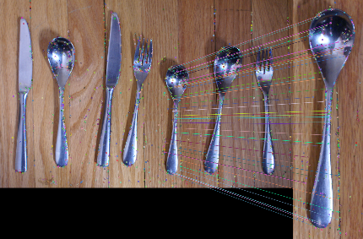
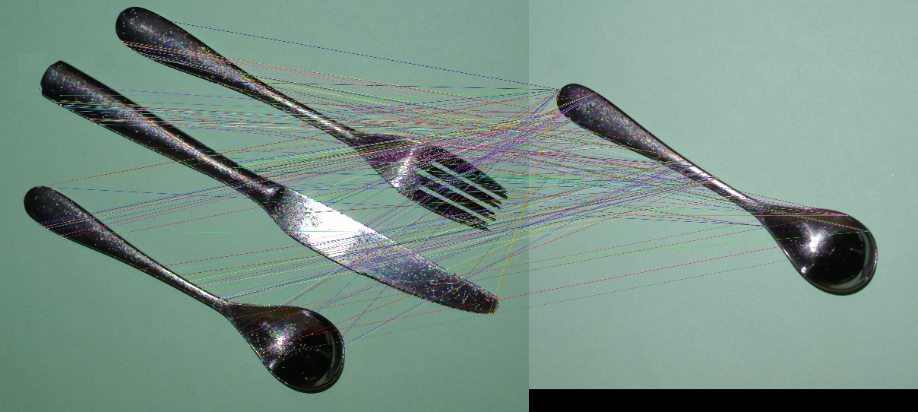
Motivation and Definition of Success

Slide 4
Data: Source and Attributes
Created homemade rig to hold the camera a fixed distance from a stainless steel tray covered with a surgical huck towel and containing stainless steel flatware
Used by both high-intensity halogen and daylight for illumination
RGB images were taken with a Sony Alpha SLR camera, downsized from the original 3872 x 2592 resolution by a factor of 4

Slide 5
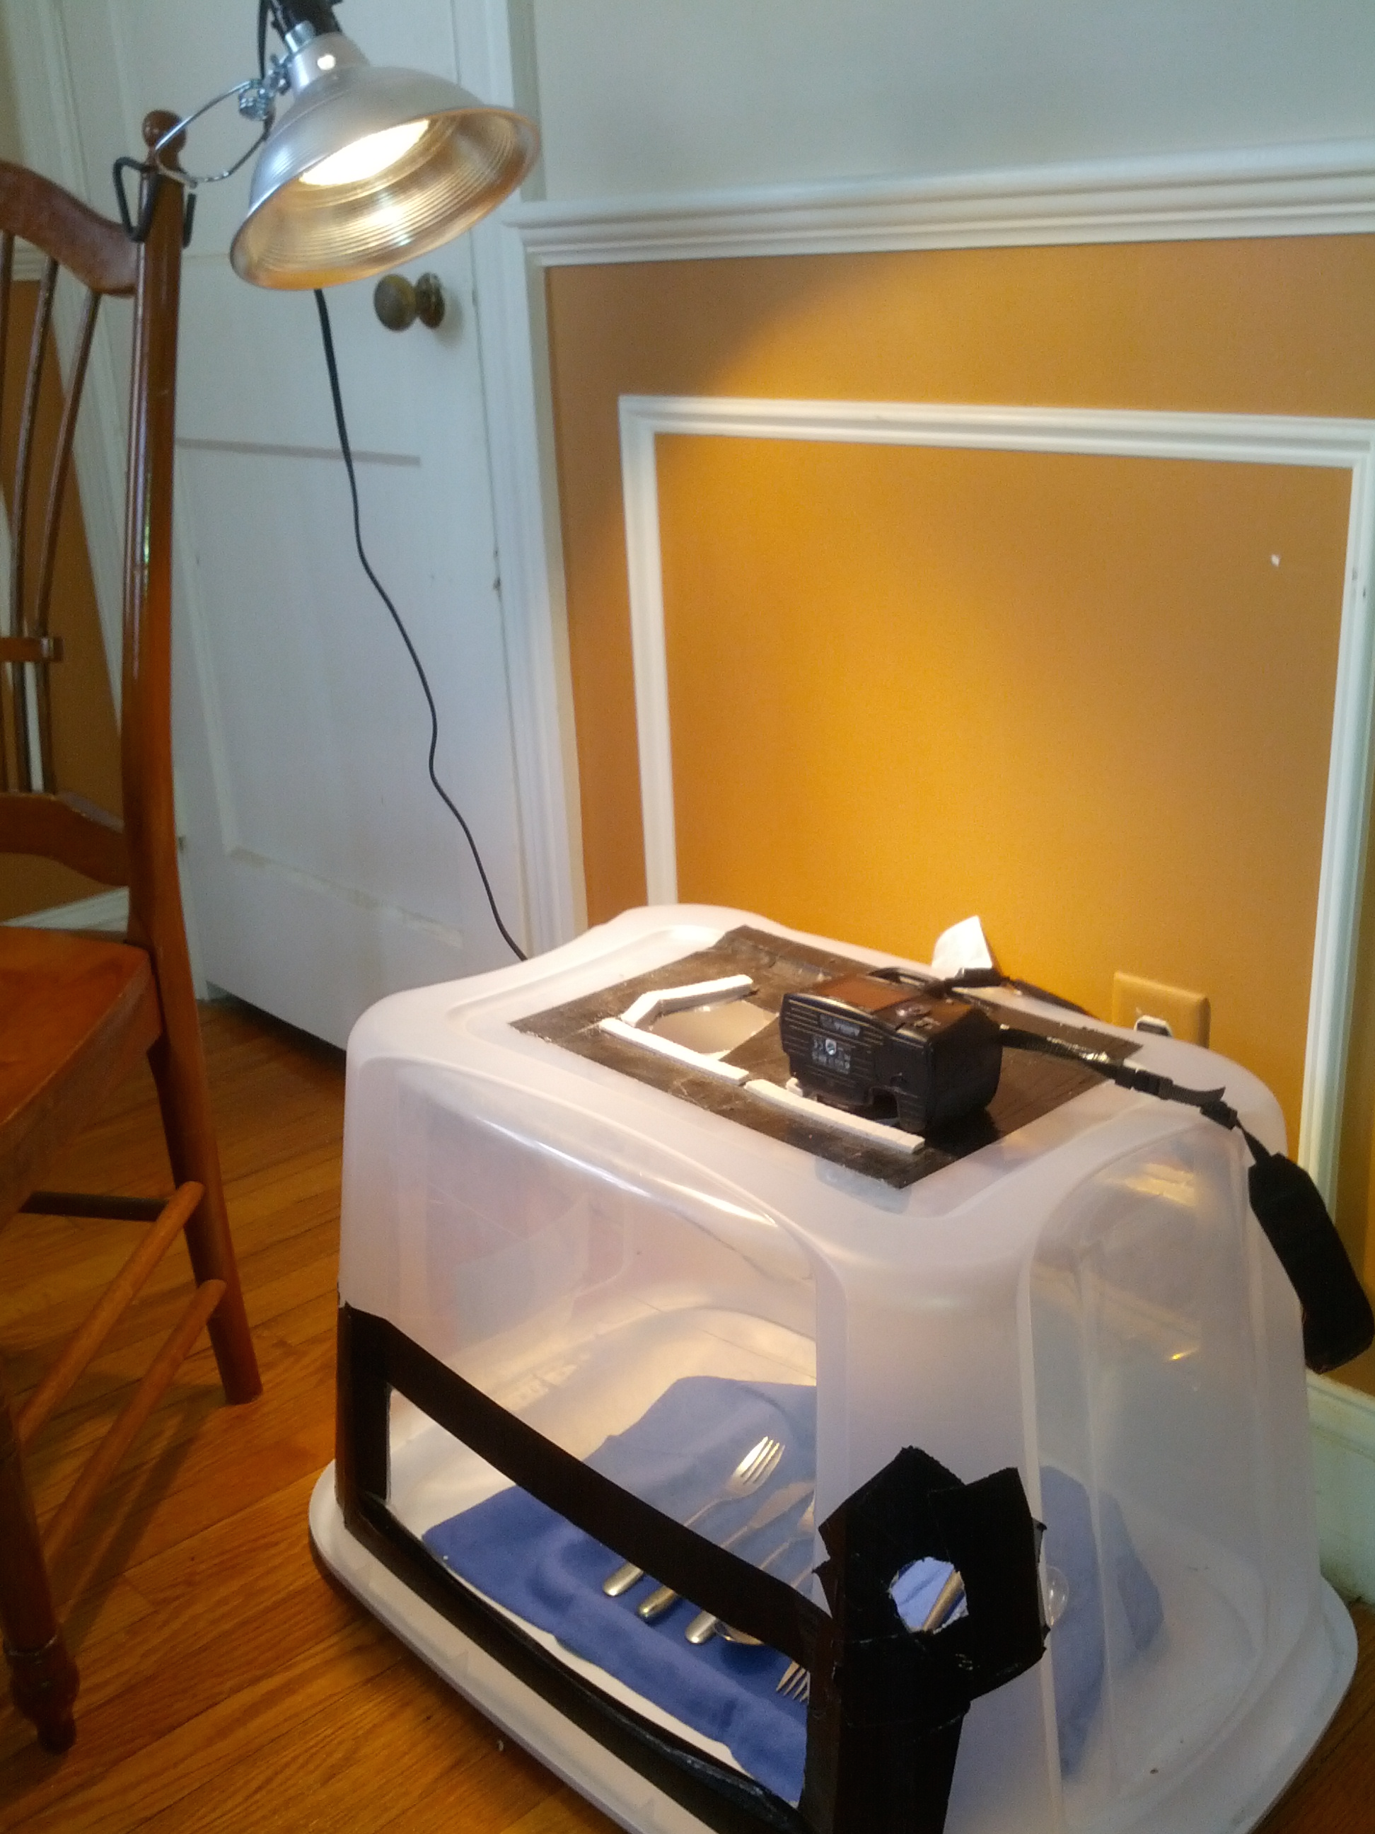
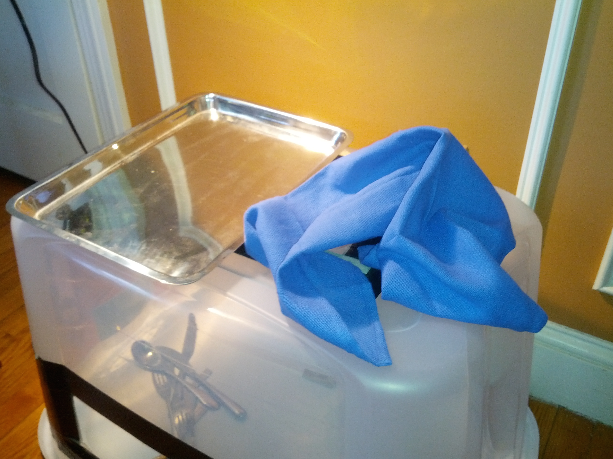
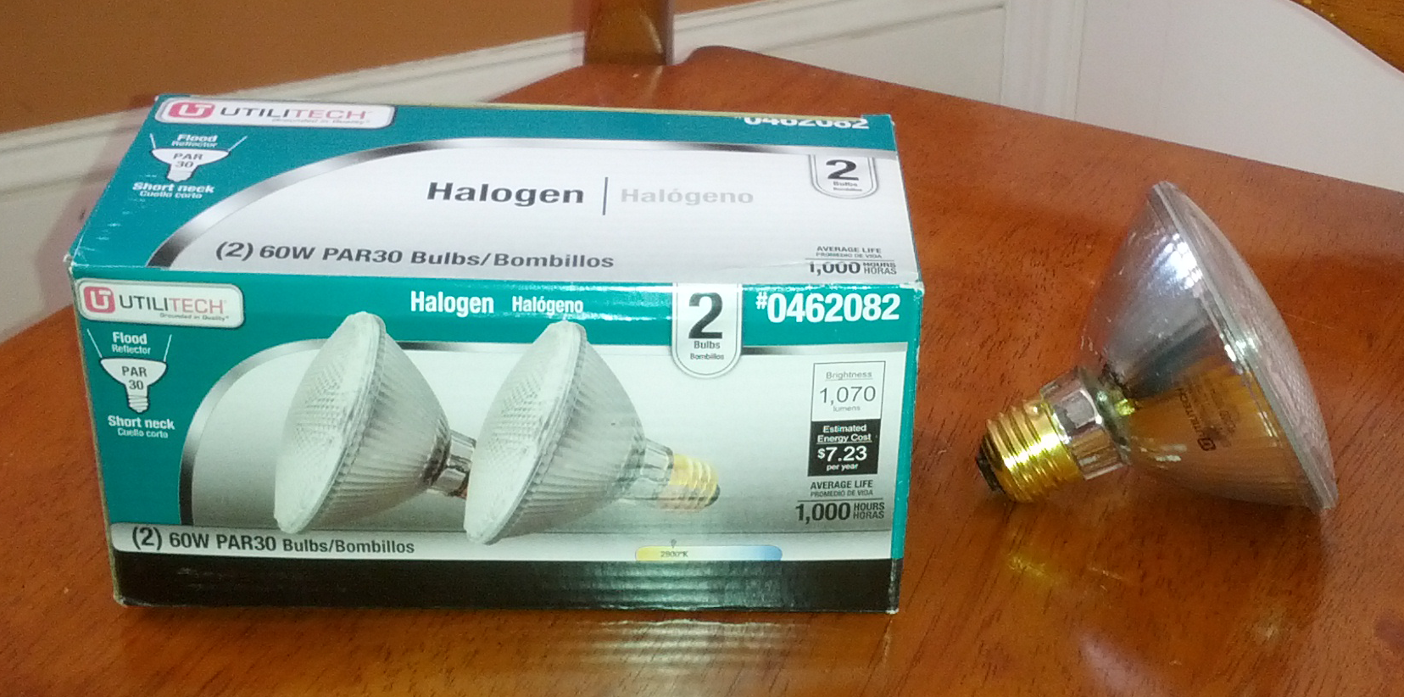
Image Acquisition Rig

Slide 6
Data Acquisition
Image were taken under simulated industrial lighting, and under natural daylight
They taken both with and without a polarizing filter in front of the camera lens
Reflections were a problem, both from objects themselves and from the tray reflecting light through the porous towel

Slide 7
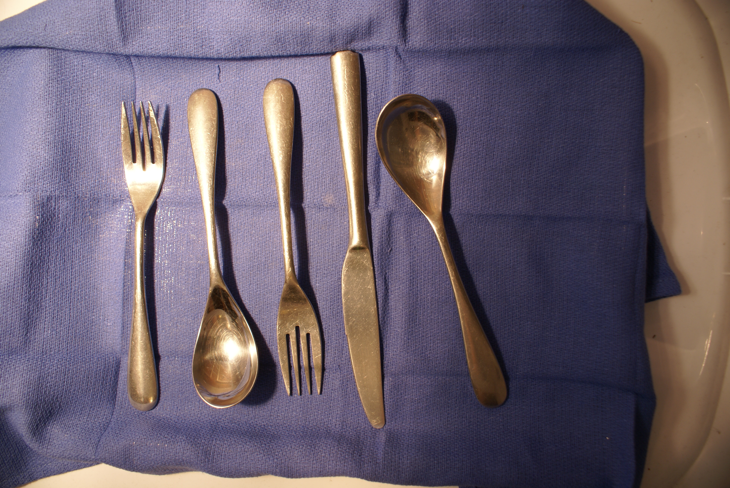
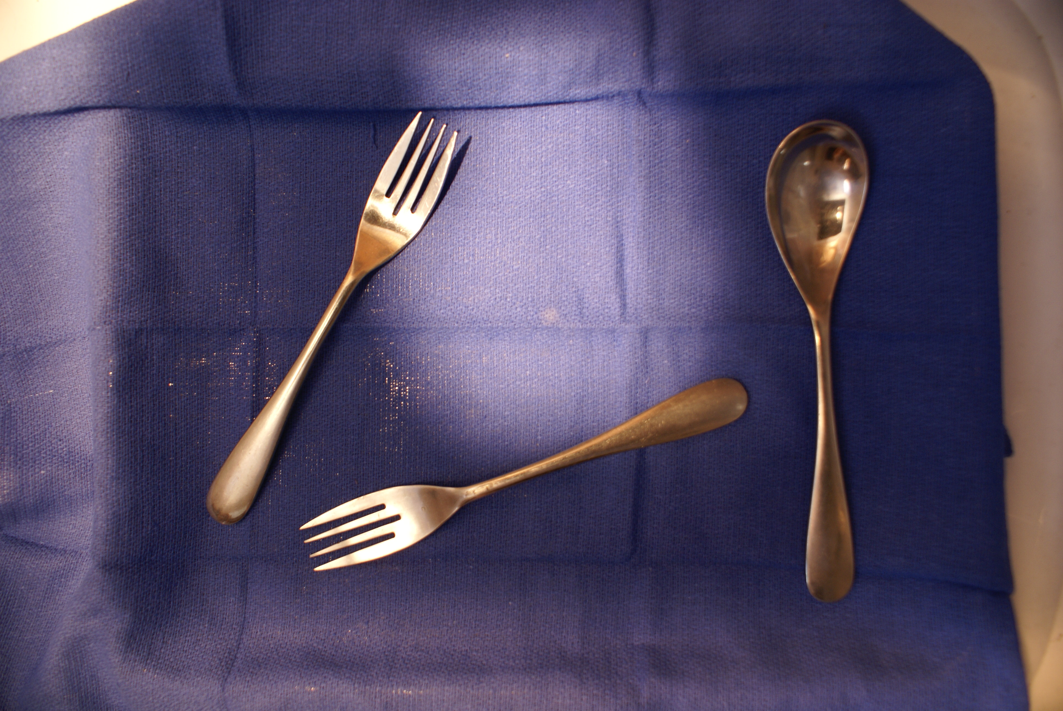
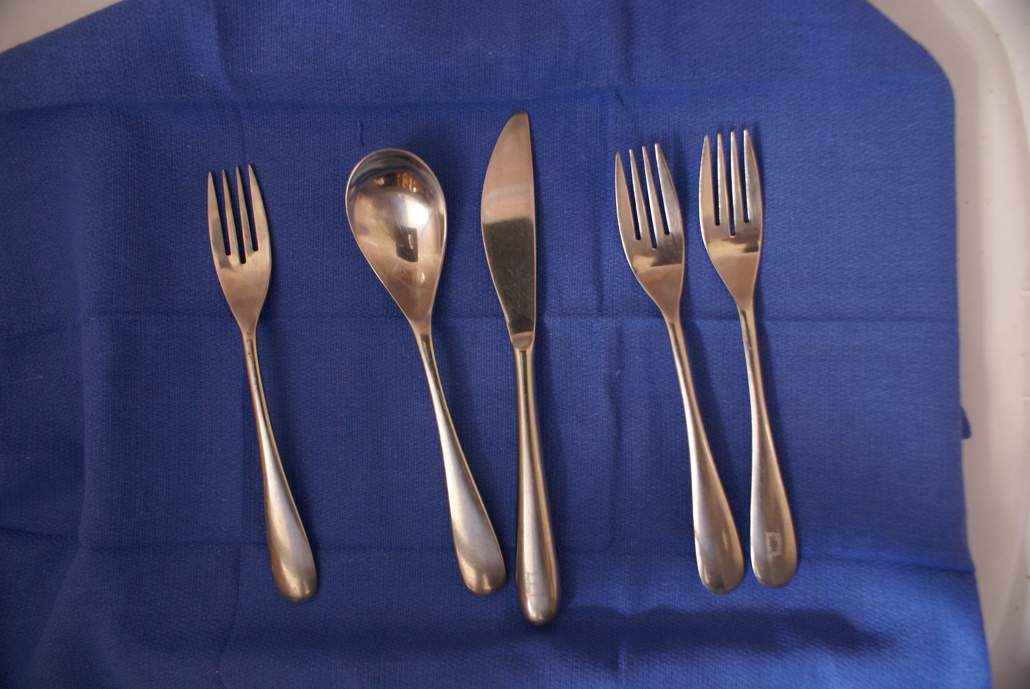
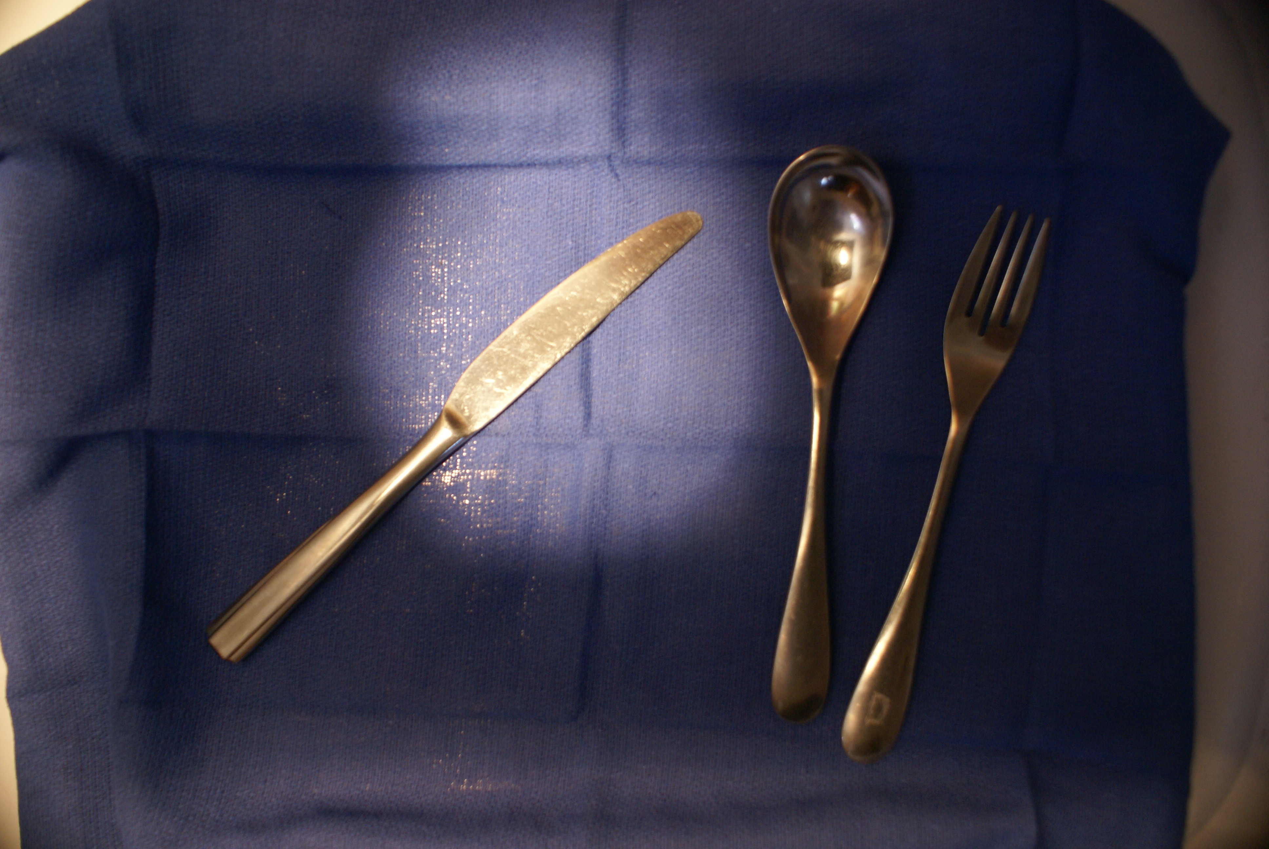
Sample Images

Slide 8
Prior Knowledge
Only had experience working with thermal images and satellite multi-spectral images. Knew nothing about object detection, recognition or tracking
Didn’t realize that OpenTLD wasn’t detecting objects correctly because it was a patch-based detection system and what I needed to being a shape-based detection system (morphological).

Slide 9
Assumptions For This Project
Task would not be too difficult because the objects had simple shapes, and I could control camera pose and lighting
Project would not involve object tracking The object inventories were snapshots in time; objects just needed to be detected and classified
Underestimated the difficulty

Slide 10
Technical Approach: What Didn’t Work
Started with Canny edge detection. The reflections in the flatware created artificial edges. There were also gaps that couldn’t be closed with simple dilation
Canned segmentation, like Fiji’s level-set, active contours plugin. Either flowed over object edges or got stuck at suboptimal, background boundaries
Harris-Stephens corner detection either detected false corners, or missed significant corners like the ends of the tines on the forks

Slide 11
Technical Approach: What Worked
1. Change from RGB to YCrCb color space because the value of the green pixel always resides between the two other bands and is usually close to the blue.
2. Use k-means clustering to create super-pixels, background vs. object
3. During calibration the user chooses background. System saves the k-mean’s centers, color palette and background class values to use on subsequent images.
4. Remove the background

Slide 12
Technical Approach
5. Do a morphological opening to remove noise pixels and close holes
6. Run flood fill algorithm to identify and enumerate objects
7. Calculate Hu Invariants, area and contour length
8. Classify unknown objects using table of known objects with their saved Hu invariants, and compactness descriptors
9. Count the classified objects

Slide 13
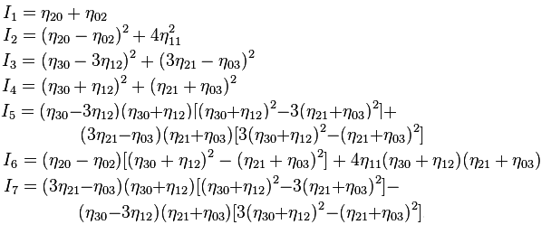
Technical Approach
Intensity, scale, and rotational invariant Hu’s moments:
Compactness = Area / Contour Length

Slide 14
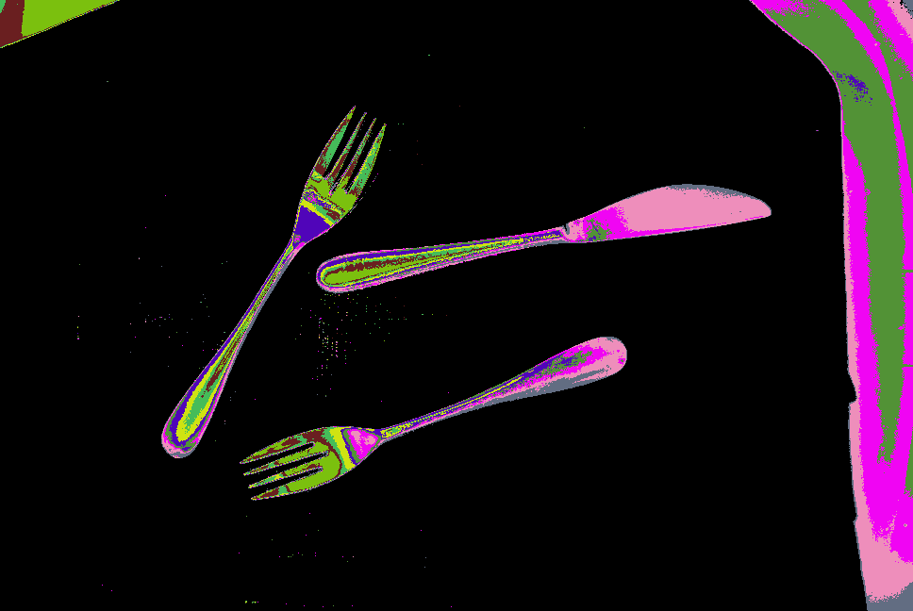
Technical Approach
Object | Hu Invariants |  |  |  |  |  |  |  | Area | Perimeter | Compactness
Forks | 1.43 | 1.98 | 0.08 | 0.07 | 0.01 | 0.10 | 0.00 | 0.00 | 13408.00 | 1455.33 | 9.21
Spoons | 1.06 | 1.04 | 0.48 | 0.41 | 0.19 | 0.42 | 0.00 | 0.00 | 18589.50 | 1118.00 | 16.63
Knives | 1.29 | 1.65 | 0.10 | 0.09 | 0.01 | 0.12 | 0.00 | -0.01 | 16883.50 | 1089.50 | 15.50

Slide 15
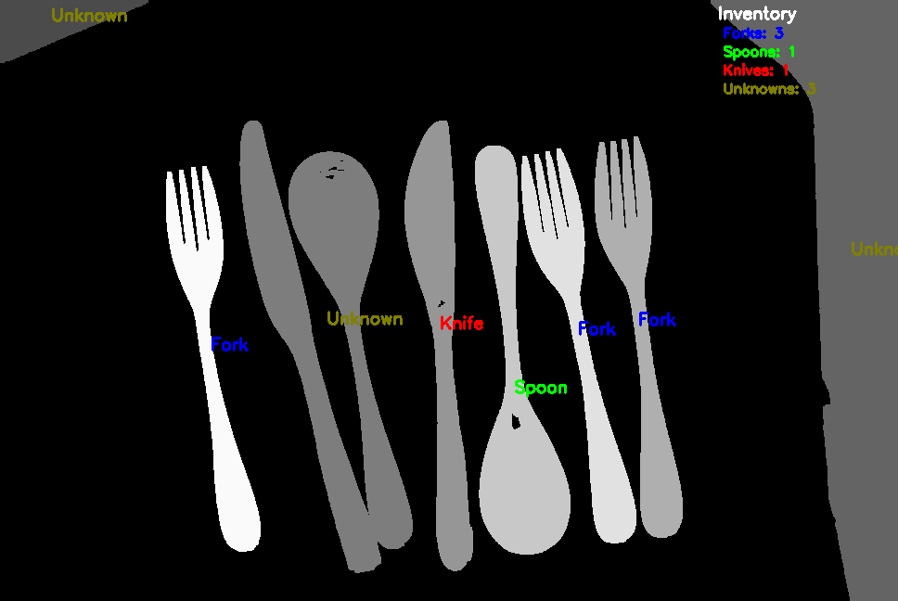
Sample Inventory Report

Slide 16
Discussion of Project Success
When the objects are separated, and the same image is used to both classify the background and to detect objects, the accuracy approaches 100%
When previously saved state, centers, and background classes are used to detect objects in a new image, there is usually at least one error.
Achieved intensity, scale and rotational invariance. Handled tray and object reflections
At this time, the system is incapable of detecting touching or overlapping (occlusion) objects
Demonstration

